Slide 1
Buttons, Levers, and Dials
What to do with common SQL Server Settings!

Slide 2





Thank You to Our Event Sponsors
We gratefully acknowledge the generous support of our sponsors.
Their partnership makes this event possible.
Global Sponsors
Silver Sponsor
Bronze Sponsors
Other Sponsor
We appreciate every sponsor for helping us create a memorable event!

Slide 3
About Me
Entered I.T. in Feb 2008
MCTS SQL Server 2008 Implementation and Maintenance in May 2013
Azure Fundamentals and Azure Database Fundamentals Spring 2021
DBA since 2014
Currently a Sr. DBA Consultant working for The SERO Group

Slide 4
Contact Info/Slides
Blog at https://leemarkum.com
Email:lmarkum@live.com
https://github.com/lmarkum

Slide 5
Agenda
Server/Instance Level Settings
Database Level Settings

Slide 6
Server Level Settings
MAXDOP

Slide 7
Server Level Settings
You're going to make a single cake together!
Eggs - Durham Butter - Raleigh
Flour - Durham Baking Powder – Raleigh
Milk - Durham Vanilla – Durham
Sugar - Durham Salt - Durham

Slide 8
Server Level Settings
You're going to make a single cake together!
Maxdop set to use all cpu -
Socket 1 – Local memory Durham Socket 2 – Local Memory Raleigh
Eggs - Durham Butter - Raleigh
Flour - Durham Baking Powder – Raleigh
Milk - Durham Vanilla – Durham
Sugar - Durham Salt - Durham

Slide 9
Buttons Levers and Dials
Server/Instance Level Settings

Slide 10
Server Level Settings
MAXDOP
This setting controls how many CPU cores are used when a query goes parallel
The default setting is zero, which lets SQL Server use all available cores
The MAXDOP limit is set per task. Each request/session can start multiple tasks

Slide 11
Server Level Settings
MAXDOP
NUMA: https://bit.ly/4kkVGbv What Is Non-Uniform Memory Access (NUMA)? | IDERA
“Each physical socket and its directly attached RAM is known as a node hence a two-socket computer would have two NUMA nodes, a four socket would have four NUMA nodes, etc.”

Slide 12
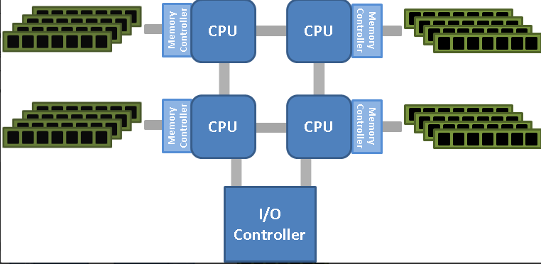
Server Level Settings
MAXDOP: Image from https://bit.ly/3HBOrxj Understanding Non-Uniform Memory Access/Architectures (NUMA) - Jonathan Kehayias

Slide 13
Server Level Settings
MAXDOP
MS Recommendation on MAXDOP: https://bit.ly/3HhGb5N
Two recommendations:
SQL Server 2014 and older
SQL Server 2016 and newer

Slide 14
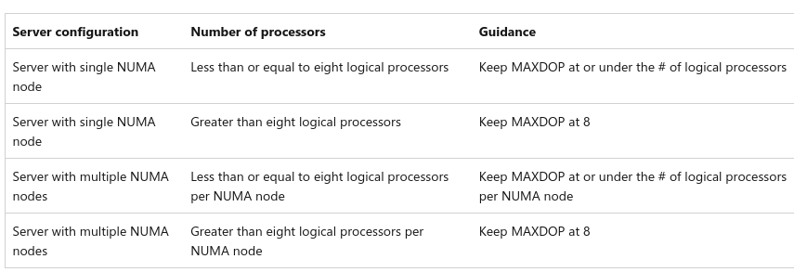
Server Level Settings
MAXDOP - SQL Server 2014 and older:

Slide 15
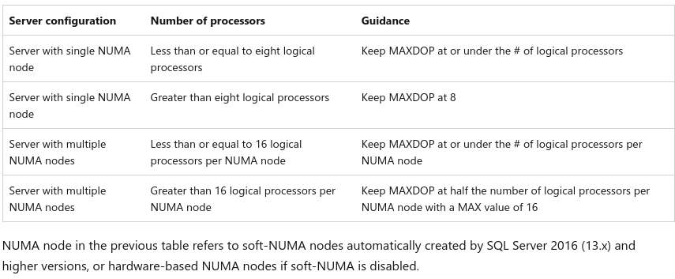
Server Level Settings
MAXDOP - SQL Server 2016 and older

Slide 16
Server Level Settings
You're going to make a single cake together!
2 NUMA Nodes w/4 "cores" each, but MAXDOP is set to 8 when it should be 4
Socket 1 – Local memory Durham Socket 2 – Local Memory Raleigh
Eggs - Durham Butter - Raleigh
Flour - Durham Baking Powder – Raleigh
Milk - Durham Vanilla – Durham
Sugar - Durham Salt - Durham

Slide 17
Server Level Settings
MAXDOP
How can you see NUMA and CPU/Core Count?
SELECT n.node_id, -- NUMA node identifier
n.memory_node_id, -- Memory node ID (usually same as node_id)
n.cpu_count AS node_cpu_count, -- Number of CPUs in this NUMA node
FROM sys.dm_os_nodes AS n
JOIN sys.dm_os_schedulers AS s ON n.node_id = s.node_id
WHERE s.status = 'VISIBLE ONLINE' -- excludes hidden or DAC schedulers
AND s.is_online = 1
AND s.scheduler_id < 1048576 -- filters out internal schedulers

Slide 18
Server Level Settings
MAXDOP
SQL Server 2019 (15.x) introduced automatic recommendations for MAXDOP in the installer. It detects the NUMA for you and makes a recommendation.
If you want more gritty details, check out this blog post.
https://erikdarling.com/thoughts-on-maxdop/

Slide 19
Server Level Settings
COST THRESHOLD FOR PARALLELISM

Slide 20
Server Level Settings
CTFP
This setting is the minimum estimated cost a query must reach in order for SQL Server to consider parallel plans.
The current default is 5. It comes from the 90’s when a person at Microsoft set the value based on how long a query took to run on their hardware.

Slide 21
Server Level Settings
CTFP
Why is a default of 5 too low?
Advancements in hardware mean that a “big, costly” query in the 90’s is a TINY, LOW COST query now. An average query now has a cost that is much larger than in the 90’s and so it will go parallel when CTFP is set to 5. This results in queries going parallel that don’t need to.

Slide 22
Server Level Settings
CTFP
A common guideline is to set CTFP to 50
https://bit.ly/4dPuL5l Eitan Blumin's blog
Querying the plan cache to see what queries go parallel at a certain cost threshold

Slide 23
Server Level Settings
MAX SERVER MEMORY

Slide 24
Server Level Settings
MAX Server Memory
Poor default of 2 Petabytes(2000 Terabytes) - This default can cause memory pressure with the OS

Slide 25

Server Level Settings
MAX Server Memory
Photo by Hermes Rivera on Unsplash

Slide 26
Server Level Settings
MAX Server Memory
A significant part of SQL Server process memory has been paged out. This may result in a performance degradation. Duration: %d seconds. Working set (KB): %I64d, committed (KB): %I64d, memory utilization: %d%%.

Slide 27
Server Level Settings
MAX Server Memory
https://bit.ly/3Mv9csa: Identifying-external-memory-pressure Jonathan Kehayias
RESOURCE_MEM_PHYSICAL_LOW indicators in the ring buffer for Process (internal) and System(external) causes.

Slide 28
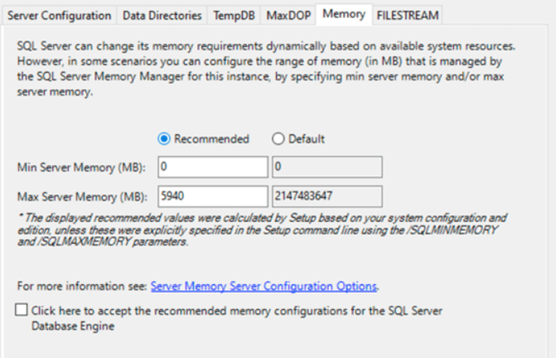
Server Level Settings
MAX Server Memory
Installer now lets you set a more reasonable recommendation

Slide 29
Server Level Settings
MAX Server Memory
What about your SQL Servers that are already installed?

Slide 30
Server Level Settings
MAX Server Memory
How to view current settings and the recommendation for Max Server Memory across your environment:
Based on Jonathan Kehayias's memory calculation methodology
$sqlinstances = get-content -path “C:\MyDocuments\SQLServerList.txt”
$sqlinstances | test-dbamaxmemory

Slide 31
Server Level Settings
MAX Server Memory
How to set the Max Server Memory across your environment:
$sqlinstances = get-content -path “C:\MyDocuments\SQLServerList.txt”
$sqlinstances | set-dbamaxmemory
This can also be done using Get-DbaRegServer

Slide 32
Server Level Settings
MAX Server Memory
Why memory is so critical to SQL Server performance:
Allocate too much and OS memory pressure happens
Allocate too little and you could strain storage and make queries slower
Allocate too little and you could cause resource-semaphore waits

Slide 33
Buttons Levers and Dials
Database Level Settings

Slide 34
Database Level Settings
QUERY STORE

Slide 35
Database Level Settings
Query Store
Stores query runtime performance from the perspective of cpu, duration, logical reads and other metrics
Captures execution plans
Wait Stats information is available in SQL Server 2017 and above
Custom Capture Policies in 2019 allow for more control over what/how much is captured

Slide 36
Database Level Settings
Query Store
In SQL Server 2022, can apply query hints without changing the code
Allows you to detect regression and force “good query plans”
Involved in IQP features: DOP Feedback, Memory Grant Feedback, and others

Slide 37
Database Level Settings
Query Store
Query_Store_Capture_Mode: Determines the behavior Query Store uses to capture queries.
Default is ALL for 2016/2017(change this to auto!!)
Auto is default in 2019 and higher
Custom Mode available in 2019.

Slide 38
Database Level Settings
Query Store
Max_Storage_Size_MB: The largest size query store can grow to on disk. Defaults are too small for most scenarios(100 MB in 2016/17, 1000 MB in 2019)
This setting will trigger auto-cleanup of old data once a certain free space threshold is reached.

Slide 39
Database Level Settings
sys.database_scoped_configurations
What are they?
How can you see what the options are?
SELECT configuration_id, name, value, value_for_secondary
FROM sys.database_scoped_configurations;

Slide 40
Database Level Settings
COMPATIBILITY LEVEL/LEGACY CARDINALITY ESTIMATION

Slide 41
Database Level Settings
Compat Level/Legacy Cardinality Estimation
Compatibility Level controls the feature set the database uses. For example, what T-SQL features are available to use, what trace flags, query optimization, and processing features are accessible.

Slide 42
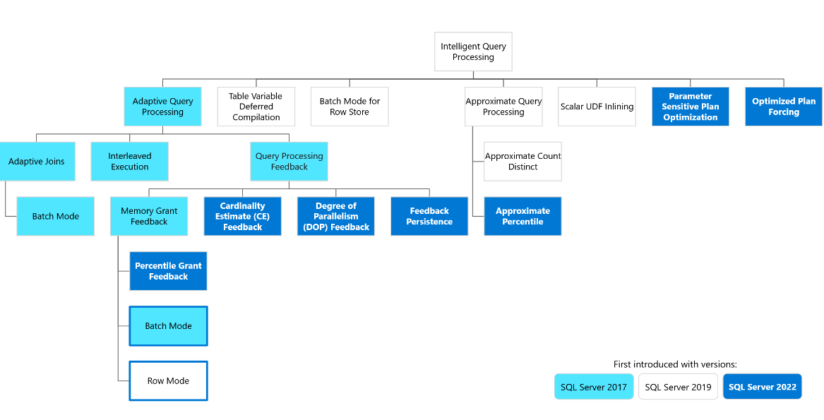
Database Level Settings
Compat Level/Legacy Cardinality Estimation
https://bit.ly/3C0Zn1B IQP Summary MS Learn. Certain compat levels are needed

Slide 43
Database Level Settings
Compat Level/Legacy Cardinality Estimation
The Cardinality Estimator controls the logic the engine uses to create query plans.
Why does this matter? Anyone remember what happened in 2014?

Slide 44
Database Level Settings
Compat Level/Legacy Cardinality Estimation
SQL Server 2016 introduced database scoped configurations. One of those was Legacy Cardinality Estimation so workloads would have their query plans created in the same way as before, even on newer compat levels.
Use this setting when migrating older databases to newer versions of SQL Server

Slide 45
Database Level Settings
sys.database_scoped_configurations
LEGACY_CARDINALITY_ESTIMATION:
LIGHTWEIGHT_QUERY_PROFILING: Query performance and progress for in-flight queries. Can help you determine when index rebuilds will finish.
LAST_QUERY_PLAN_STATS/SYS.DM_EXEC_QUERY_PLAN_STATS: These are used in combination to retrieve the last known actual plan for a query.

Slide 46
Database Level Settings
sys.database_scoped_configurations
DOP_FEEDBACK:
MEMORY_GRANT_FEEDBACK:
CE_FEEDBACK:

Slide 47
Database Level Settings
sys.database_scoped_configurations
How to change the database scoped configurations?
ALTER DATABASE SCOPED CONFIGURATION SET featurenamehere = ON;
https://www.sqlskills.com/blogs/jonathan/logging-database-scoped-configuration-changes/

Slide 48
Buttons Levers and Dials
Other Settings to Think About:
Accelerated Database Recovery
ZTF Backup Compression
Target Recovery Time(seconds)/Indirect Checkpointing

Slide 49
Buttons Levers and Dials
Questions ?

Slide 50
Contact Info/Slides
Blog at https://leemarkum.com
Email:lmarkum@live.com
https://github.com/lmarkum

